Slide 1
CLASS SEVEN
class, main(), variables, methods, console i/o, conditionals, Loops
Primitive Types, Strings, Arrays, Arraylists

Slide 2
Java's primitive types
primitive types: Java's built-in simple data types for numbers, text characters, and logic.
Java has eight primitive types total.
Types that are not primitive are called object types.
We'll use these four primitive types in this class primarily:
Name Description Examples
int integers (whole numbers) 42, -3, 0, 926394
double real numbers 3.14, -0.25, 9.0
char single text characters 'a', 'X', '?', '\n'
boolean logical values true, false
Notes:
We're basically going to manipulate letters and numbers.
We make the integer / real number distinction in English as well. We don't ask, "How many do you weigh?" or, "How much sisters do you have?"
Part of the int/double split is related to how a computer processor crunches numbers. A CPU does integer computations and a Floating Point Unit (FPU) does real number computations.
Why does Java separate int and double? Why not use one combined type called number?

Slide 3
Strings are not a primitive type
We have been using Strings to communicate with the user
“Hello, World!”
We haven’t really talked about how Java represents strings inside the computer or how you might manipulate the characters that make up a string
Strings on a low-level (code level) are very complex
Java supports a high-level view of Strings by making a String class whose methods hide the underlying complexity

Slide 4
String Class Methods
Java defines many useful methods that operate on the String class.
None of the methods in Java’s String class change the value of the string used as the receiver. What happens instead is that these methods return a new string on which the desired changes have been performed.
Classes that prohibit clients from changing an object’s state are said to be immutable. Immutable classes have many advantages and play an important role in programming.

Slide 5
Strings vs. Characters
In the String class, you apply toUpperCase to an existing string, as follows:
str = str.toUpperCase();
Note that you need to assign the result back to the original variable if you want to change its value.

Slide 6
Selecting Characters from a String
Conceptually, a string is an ordered collection of characters or an array of characters
In Java, the character positions in a string are identified by an index that begins at 0 and ends at one less than the length of the string (sound familiar?)
You obtain the number of characters by calling length()
You can select an individual character by calling switching the String to a character array and getting the character at index I
char character = stringToCharArray[0]; //will return ‘T’

Slide 7
String Concatenation
Putting two strings together, we can use the ‘+’ and we’ve done that before in class and in hw assignments
The String class exports a method called concat() to signify concatenations, but it’s almost never used because we can use +
If you use + with numeric operands, it signifies addition. If at least one of its operands is a string, Java interprets + as concatenation. When it is used in this way, Java performs the following steps:
If one of the operands is not a string, convert it to a string by applying the toString method for that class.
Apply the concat method to concatenate the values.

Slide 8
Extracting Substrings
The substring method makes it possible to extract a piece of a larger string by providing index numbers that determine the extent of the substring.
str.substring(i1, i2);
where i1 is the first index position in the desired substring and i2 is the index position immediately following the last position in the substring.
Example: from “Hello, World!” if you wanted to select the substring "ell“, you would make the following call:
str.substring(1, 4);

Slide 9
Checking Strings for Equality
Many applications will require you to test whether two strings are equal, in the sense that they contain the same characters.
Although it seems natural to do so, you cannot use the == operator for this purpose. While it is legal to write
if (s1 == s2) {…}
The if test will not have the desired effect.
== checks whether the objects are identical, aka does the reference in memory point to the same address (which would be true for primitive types)
To check if two strings are equal:
if( s1.equals(s2) ) {…}

Slide 10

Searching a String
Java’s String class includes several methods for searching within a string for a particular character or substring.
The method indexOf takes either a string or a character and returns the index within the receiving string at which the first instance of that value begins.
If the string or character does not exist at all, indexOf returns -1. For example, if the variable str contains the string "hello, world":

Slide 11
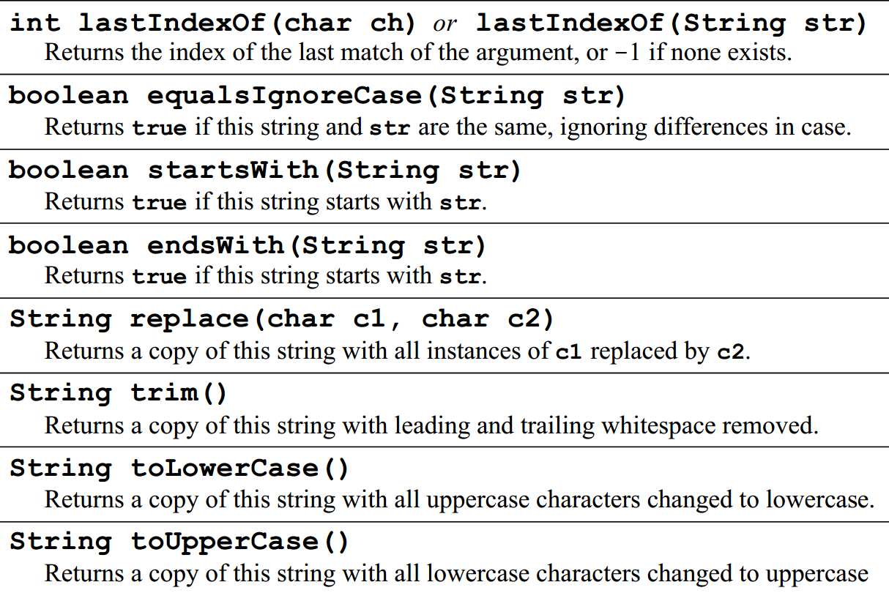
String Methods

Slide 12
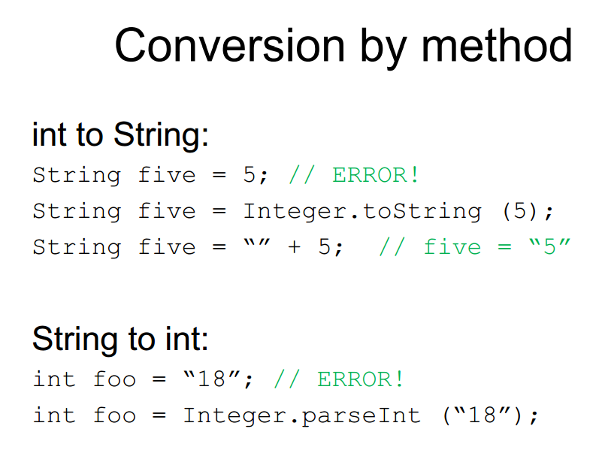

Slide 13
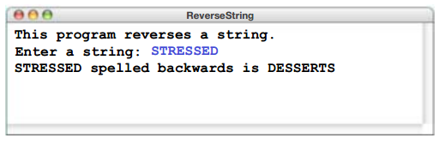
String Exercise – Reverse a String

Slide 14
Arrays Review

Slide 15
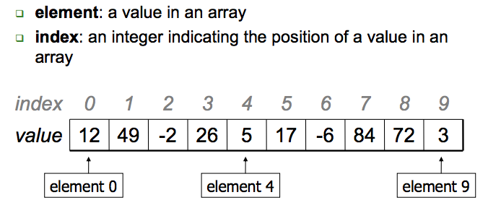
Arrays
An array is an indexed list of values.
You can make an array of any type int, double, String, etc.
All elements of an array must have the same type.
Notes:
An array is a set of values where each value is identified by an index. You can make an array of ints, doubles, or any other type, but all the values in an array have to have the same type.
Syntactically, array types look like other Java types except they are followed by []. For example, int[] is the type “array of integers” and double[] is the type “array of doubles.”
The primary purpose of an array is to facilitate storing and manipulating large quantities of data.
An array stores a sequence of values that are all of the same type.

Slide 16
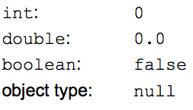
Array Initialization
double [] a = new double[5];
OR
double [] a = {1, 2, 3, 4, 5}
Default values:
The default initial value is:
zero for numbers
false for type boolean
null for String (and other non-primitive type)
Notes:
Use new to allocate memory for an array before accessing any of its elements

Slide 17
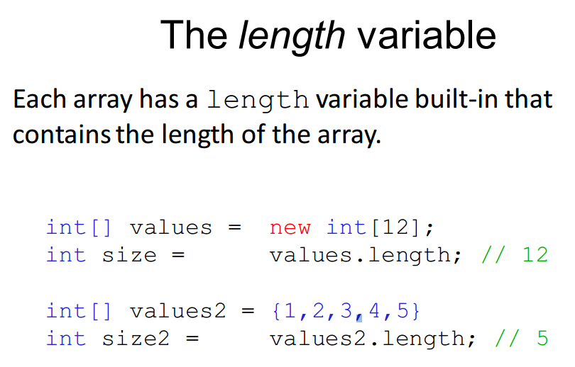
Notes:
ArrayIndexOutOfBounds

Slide 18
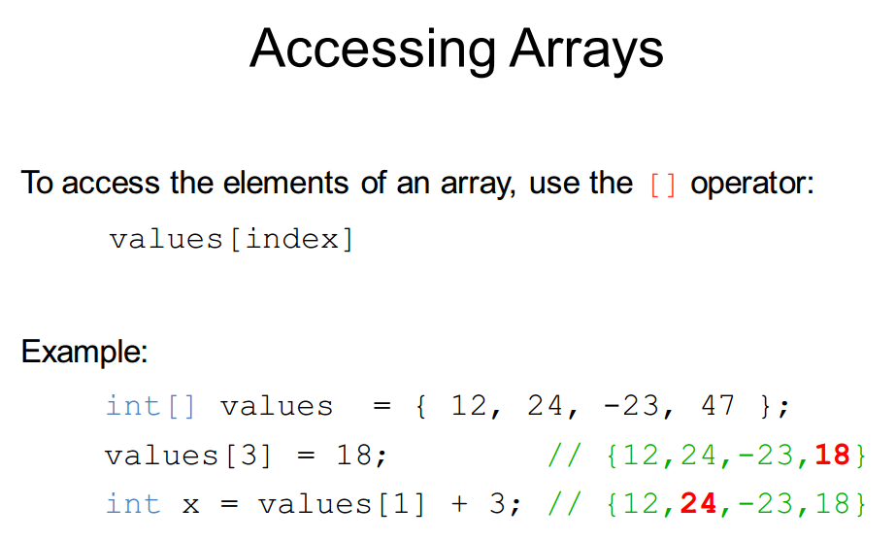

Slide 19
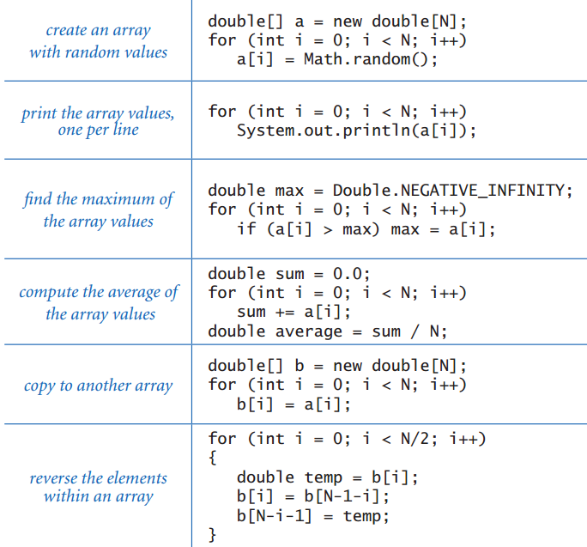
Combining Loops & Arrays

Slide 20
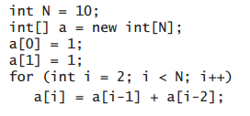

Slide 21
ArrayLists
Notes:
•Although arrays are conceptually important as a data structure, they are not used as much in Java as they are in most other languages, partly because the java.util package includes a class called ArrayList that provides the standard array behavior along with other useful operations.
The main difference between a Java arrays and an ArrayList is that ArrayList is a Java class rather than a special form in the language. This design has the following implications: – All operations on ArrayLists are specified as method calls. – You get the number of elements by calling the size method. – You use the get and set methods to select individual elements.

Slide 22
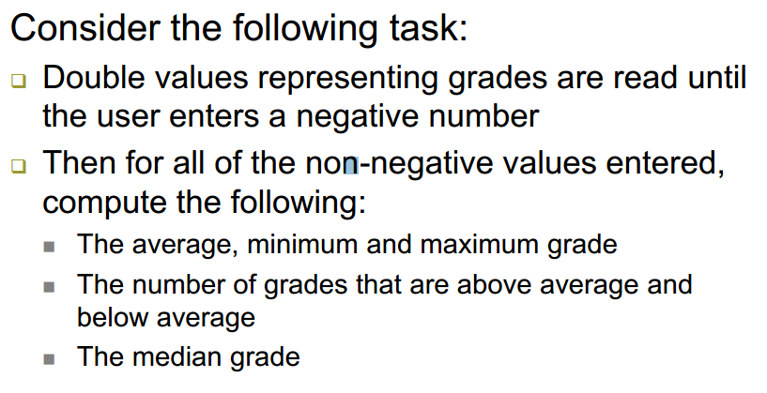
A Programming Problem

Slide 23
A programming problem
If we knew how many grades there were going to be, we could use an array But we don’t know how many grades there will be. We just want to keep reading until we find a negative score
An array requires us to know before we start using it how big it will be. We need to declare it with a specific size
double[] grades = new double[30];
What we would like to have is an array that can change size as we use it

Slide 24
ArrayLists
Dynamically Changing Sized Arrays
Same basic functionality that comes with a standard array
Stores an ordered collection of values
allows access to the values via an index
Has an additional functionality:
Grows or shrinks dynamically by inserting and deleting elements at any specified location

Slide 25
How to create & use ArrayLists
ArrayList is defined in the Java API’s java.util package
So you must import: import java.util.ArrayList;
ArrayList is a class that is part of the Java standard library - Just like Scanner
To initialize, see syntax:
ArrayList<element-type> NAME = new ArrayList<>();
So:
ArrayList<String> grades = new ArrayList<>();

Slide 26
Arrays vs. ArrayLists
ACTION | Arrays | ArrayLists
Capacity | Fixed at Creation | Flexible
Getting an element | grades[i] | grades.get(i)
Creation | new double[30] | new ArrayList<Double>()
How to get capacity | grades.length | grades.size()

Slide 27
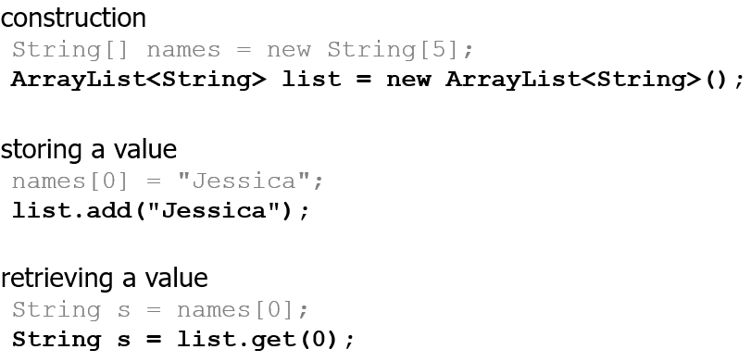
Arrays vs. ArrayLists

Slide 28
ArrayList Generic Types
When you declare or create an ArrayList, you should always specify the element type in angle brackets.
Generic specifications can be used only with object types and not with primitive types. Thus, while it is perfectly legal to write a definition like
ArrayList<String> names = new ArrayList<String> ();
It is not legal to write
ArrayList<int> numbers = new ArrayList<int>();
Notes:
ArrayList can only reference types, not primitives. Integer is a class, not a primitive.
When you declare ArrayList<Integer> list1 = new ArrayList<Integer>(), you're creating an ArrayList which will store the Integer type, not the int primitive.

Slide 29

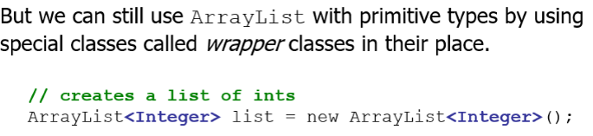
ArrayList Generic Types
To get around this problem, Java defines a wrapper class for each of the primitive types:
boolean Boolean
byte Byte
char Character
double Double
float Float
int Integer
long Long
short Short

Slide 30
Wrapper Classes – Boxing & Unboxing
Wrapper classes used to be much harder to use than they are today. Recent versions of Java include a facility called boxing and unboxing that automatically converts between a primitive type and the corresponding wrapper class.
ArrayList list = new ArrayList();
list.add(42);
int answer = list.get(0);
In the second statement, Java boxes the int value 42 inside a wrapper object of type Integer.
In the third statement, Java unboxes the Integer to obtain the original int.
Java’s automatic conversions make it appear as if one is storing primitive values in an ArrayList, even though the element type is declared to be a wrapper class.

Slide 31
ArrayList Example
ArrayList<String> myArr = new ArrayList<String>(); myArr.add("Italian Riviera"); myArr.add("Jersey Shore"); myArr.add("Puerto Rico");
ArrayList can hold elements of different types
To check the size of an ArrayList
You do size() so: myArr.size();

Slide 32
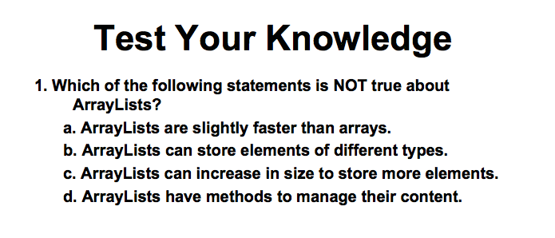

Slide 33
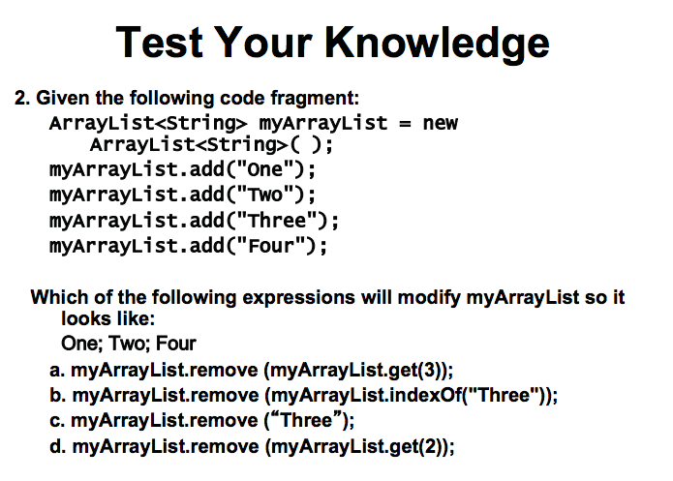

Slide 34
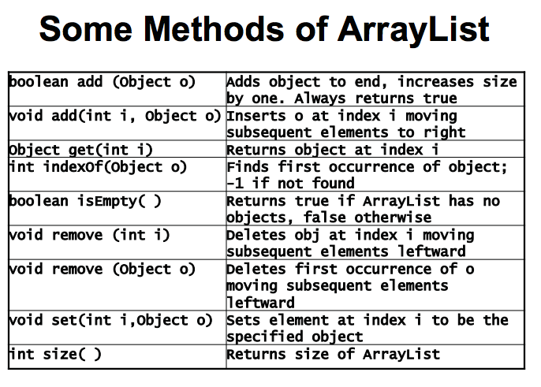
Notes:
import java.util.ArrayList; … public static void main(String [] args) { ArrayList stringList = new ArrayList(); Scanner keyboard = new Scanner(System.in); String input = “”; while (!input.equals(“stop”)) { input = keyboard.nextLine(); stringList.add(input); } int i = stringList.size()-1; while (i>0) { System.out.println(stringList.get(i)); i = i - 1; } }

Slide 35
First Problem
Let’s consider a programming problem
We want code that reads in text one line at a time until the user enters the word “stop”
Then the code should repeat back all of the lines in reverse order
We do not know how many lines of text there will be before we start

Slide 36
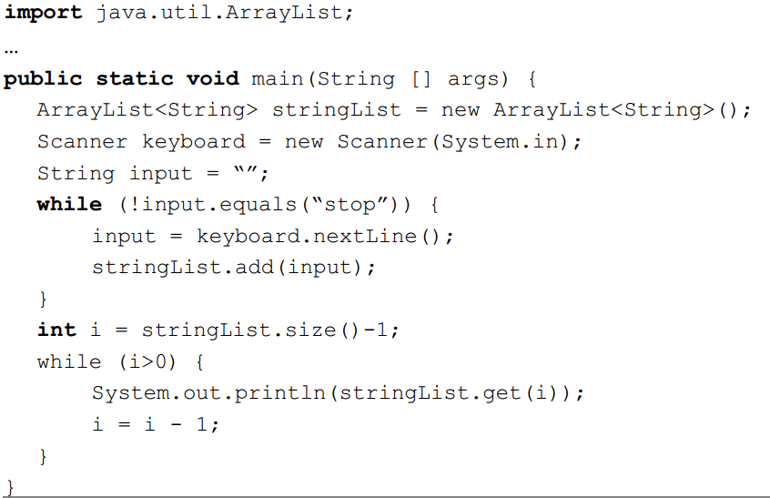
First Problem

Slide 37
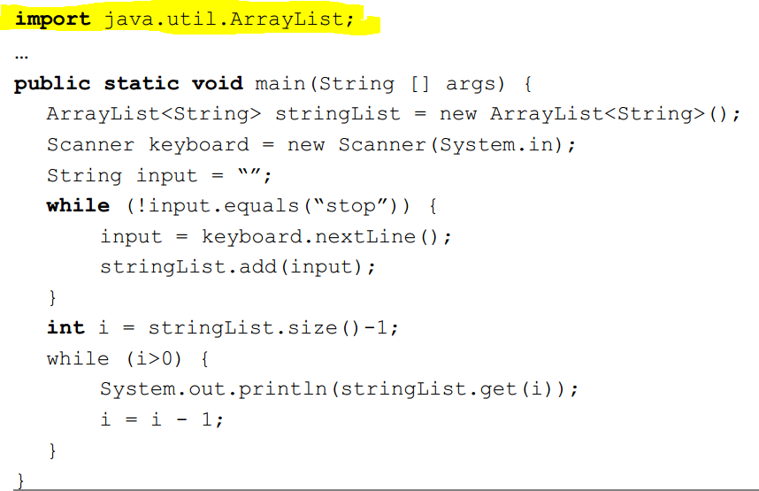
First Problem

Slide 38
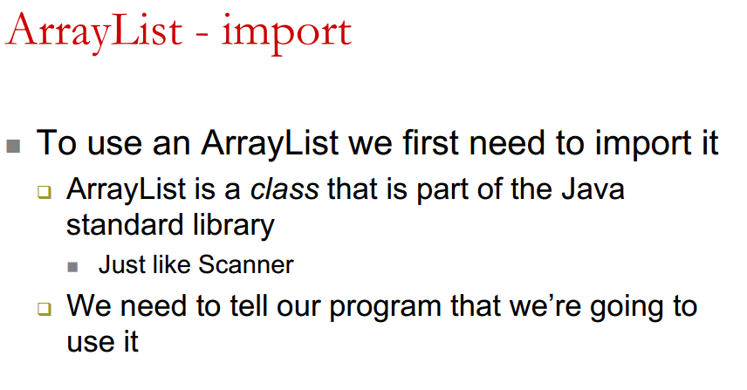
First Problem

Slide 39
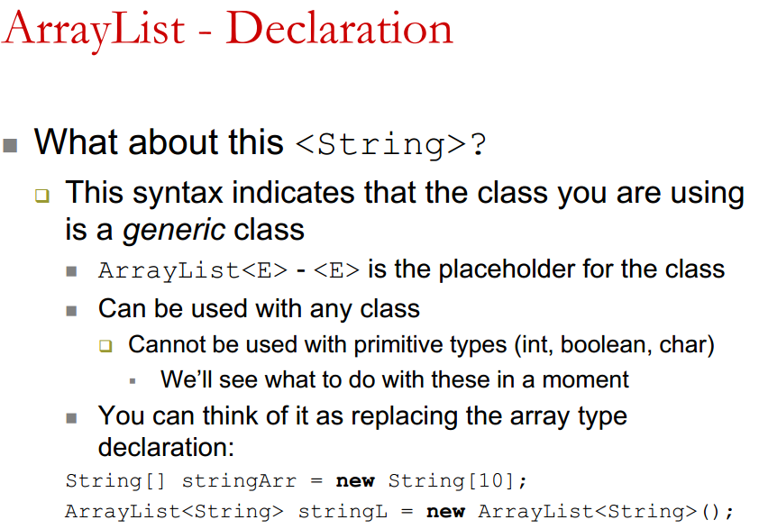
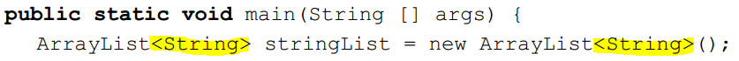
First Problem

Slide 40
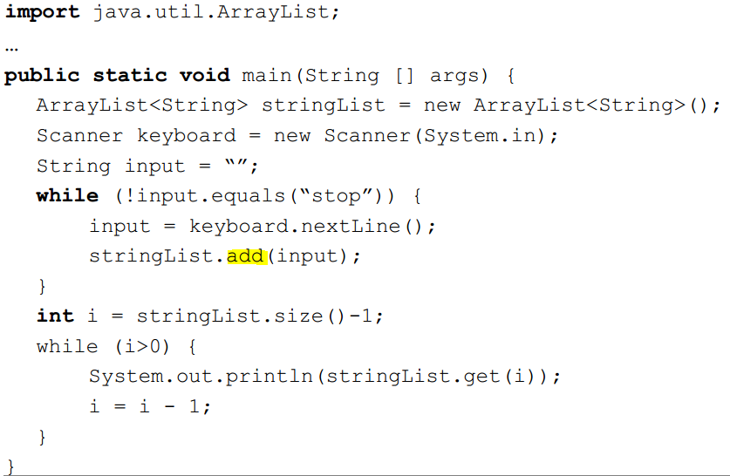
First Problem

Slide 41
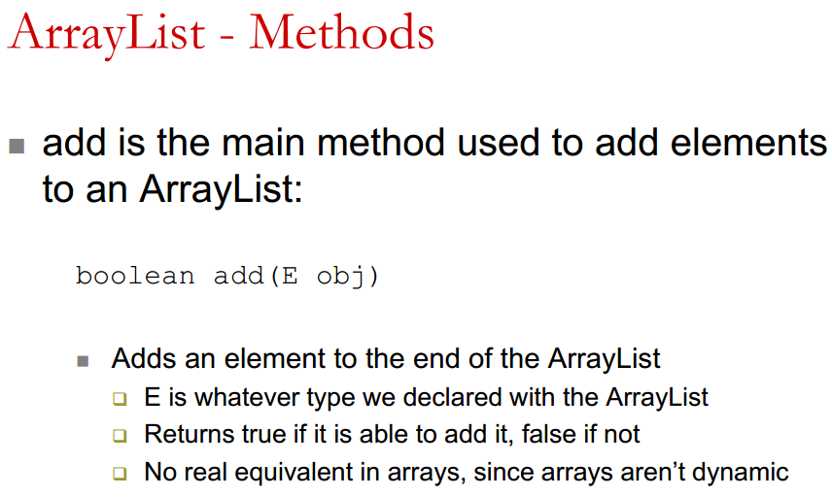
First Problem

Slide 42
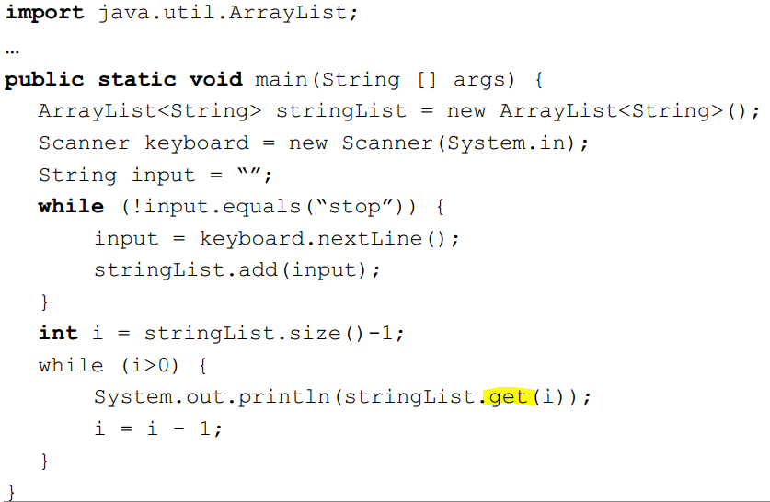
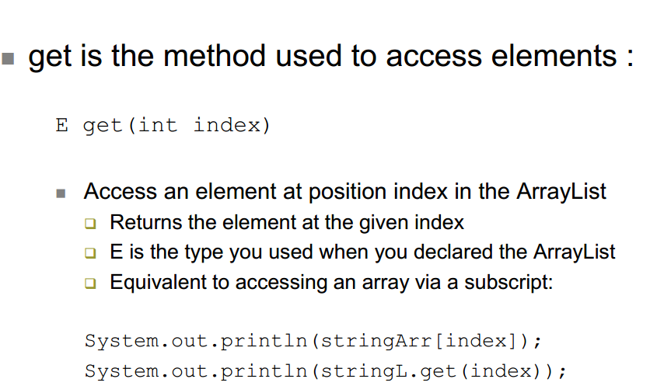
First Problem

Slide 43
First Problem

Slide 44
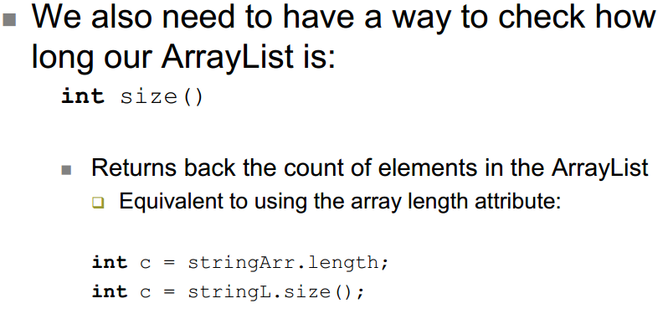
First Problem

Slide 45
First Problem

Slide 46
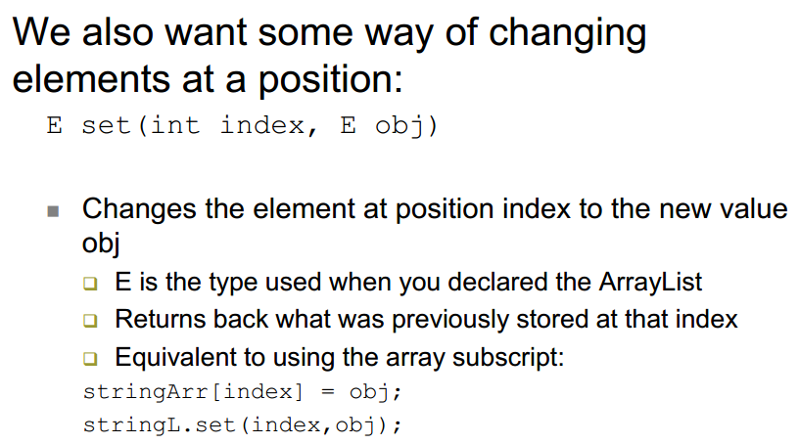
More Methods

Slide 47
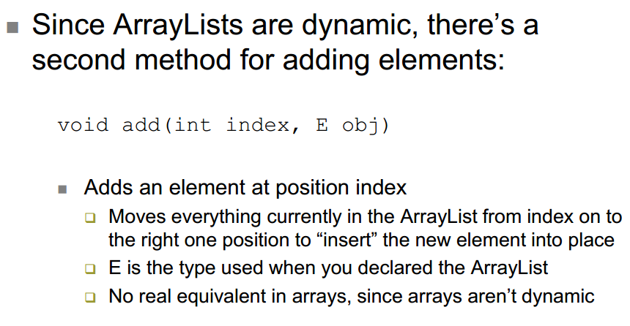
Another add method

Slide 48
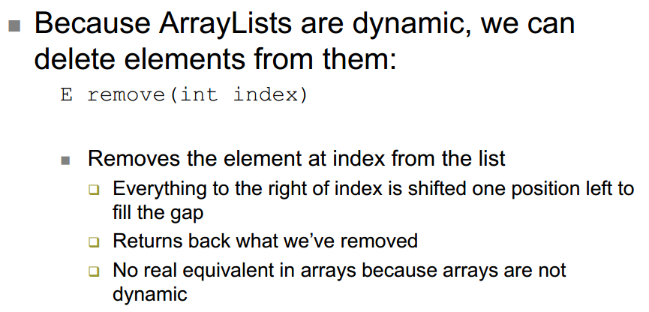
More Methods

Slide 49
Exercise
Write a segment of code that takes an ArrayList of Strings named list and removes any Strings that are longer than 5 characters

Slide 50
First Exercise
int i=0;
while (i5) {
String current = list.get(i);
if (current.length()>5) {
list.remove(i);
}
i = i + 1;
}

Slide 51
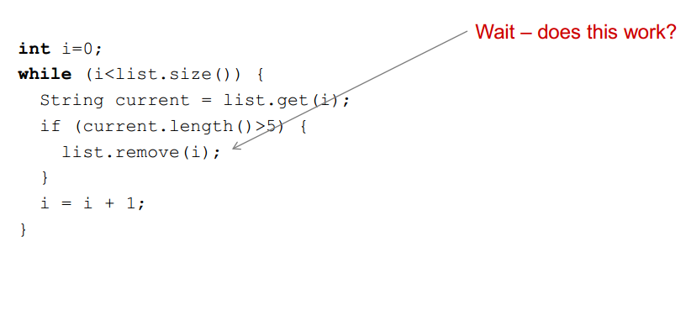
First Exercise

Slide 52
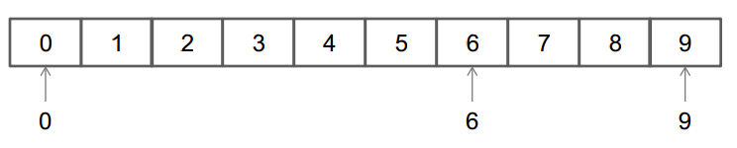
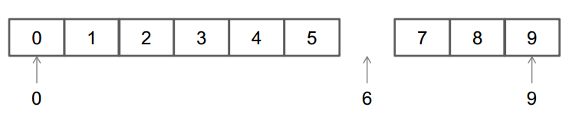
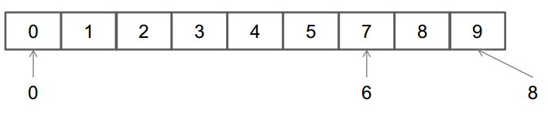
Removing Elements from a list
We need to be careful removing elements from an ArrayList
Remember – when we remove elements, the entire ArrayList shifts into the position of the removed element:
remove(6);

Slide 53
Classroom Quiz

Slide 54
Homework Problem
Write a method intersect that accepts two sorted array lists of integers as parameters and returns a new list that contains only the elements that are found in both lists.
Example: if lists named list1 and list2 initially store:
[1, 4, 8, 9, 11, 15, 17, 28, 41, 59]
[4, 7, 11, 17, 19, 20, 23, 28, 37, 59, 81]
Then the call of intersect(list1, list2) returns the list:
[4, 11, 17, 28, 59]

Slide 55
Next Time – EXAM 2 Topics
Everything until now, with a focus on material since last exam
main(), variables, methods, conditionals
Loops, Return Methods, Strings, Arrays, ArrayLists
OPEN NOTE, but notes must be printed and brought to class.
No COMPUTERS OR OTHER PEERS
Same schedule as last time: (You can start exam as early as 5)
5-6 Office Hours
6-7 Topic Review
7- Official Exam Start
Can leave when done

Slide 56
Other Exercises
Write a method reverse that reverses the order of the elements in an ArrayList of strings.
Write a method capitalizePlurals that accepts an ArrayList of strings and replaces every word ending with an "s" with its uppercased version.
Write a method removePlurals that accepts an ArrayList of strings and removes every word in the list ending with an "s", case-insensitively.

Slide 57
Exercise
Write a method addStars that accepts an array list of strings as a parameter and places a * after each element.
Example: if an array list named list initially stores:
[the, quick, brown, fox]
Then the call of addStars(list); makes it store:
[the, *, quick, *, brown, *, fox, *]
Write a method removeStars that accepts an array list of strings, assuming that every other element is a *, and removes the stars (undoing what was done by addStars above).

Slide 58
Other Exercises
Write a method reverse that reverses the order of the elements in an ArrayList of strings.
Write a method capitalizePlurals that accepts an ArrayList of strings and replaces every word ending with an "s" with its uppercased version.
Write a method removePlurals that accepts an ArrayList of strings and removes every word in the list ending with an "s", case-insensitively.

